Slide 1
Chapter 10
Evaluating Knowledge Management

Slide 2
Objectives
KM Return on Investment (ROI) and Metrics
Measuring the Success of Knowledge Networks

Slide 3
KM Return on Investment (ROI) and Metrics
The Skandia Intellectual Capital model is called the Skandia Navigator (Wall, Kirk, and Martin, 2004). Four key dimensions of business form the core of this model:
  1. Financial focus, represented in monetary terms
  2. Customer focus, a financial and nonfinancial measure of the value of customer capital
  3. Process focus, addressing the effective use of technology within the organization
  4. Renewal and development focus, which attempts to capture the innovative capabilities of the organization.

Slide 4
KM Return on Investment (ROI) and Metrics
The KM measurement process will therefore consist of the following major steps:
  1. Define the business objective(s) addressed by the KM initiative or project.
  2. Define are the stakeholders and determine what they need to know.
  3. Determine which measurement framework(s) is best to align KM measures with the business objectives.

Slide 5
KM Return on Investment (ROI) and Metrics
The KM measurement process will therefore consist of the following major steps:
  4. Modify the framework(s) based on measurements are needed.
  5. Decide on a data collection and analysis strategy.
  6. Get management to sign off on the measurement strategy.
  7. Implement measures and present the results in a form that is most appropriate for each stakeholder.

Slide 6
KM Return on Investment (ROI) and Metrics
The Benchmarking Method
  Benchmarking is a fairly straightforward KM metric that often represents a good starting point.
  There are two general types of benchmarking:
    Internal benchmarking, which involves comparisons against other units within the same organization or a comparison of a single unit over different time periods; and
    External benchmarking, which involves a comparison with other companies.

Slide 7
KM Return on Investment (ROI) and Metrics
The Benchmarking Method
  Spendolini (1992) further describes four different types of benchmarking:
  Industry group measurements
    This involves the measurement of various facets of one operation compared to similar measurements from other companies.
  Best Practice studies
    These are studies and lists of what works best. These are useful to benchmarking research, but they are not useful as metric.

Slide 8
KM Return on Investment (ROI) and Metrics
The Benchmarking Method
  Spendolini (1992) further describes four different types of benchmarking:
  Cooperative benchmarking
    This involves the measurement of key production functions of input, outputs and outcomes with the aim of improving them.
  Competitive benchmarking
    This is the study and measurement of a competitor without their cooperation for the purposes of process or product quality improvement.

Slide 9
KM Return on Investment (ROI) and Metrics
The Balanced Scorecard Method
  The balanced scorecard method (BSC) is a measurement and management system that enables organizations to clarify their vision and strategy and to translate them into action.
  It provides feedback on both the internal business processes and external outcomes in order to continuously improve strategic performance and results.

Slide 10
KM Return on Investment (ROI) and Metrics
The House of Quality Method
  The house of quality method was developed to show the connections between true quality, quality characteristics, and process characteristics.
  This was done using the Fishbone Diagram, with true quality in the heads and quality and process characteristics in the bones.
  This technique is also referred to as quality function deployment (QFD; Mazur, 1993) as it links the needs of the customer with marketing, design, development, engineering, manufacturing, and service functions.

Slide 11
KM Return on Investment (ROI) and Metrics
The House of Quality Method
  Some popular house of quality metrics used for KM projects include:
    1. The expense of reinventing solutions per year (or rework)
    2. The information/knowledge seeking time spent on average employee
    3. Number of ideas that were implemented from the suggestion box per year
    4. The percent of employees who are aware of what KM exists within their organization

Slide 12
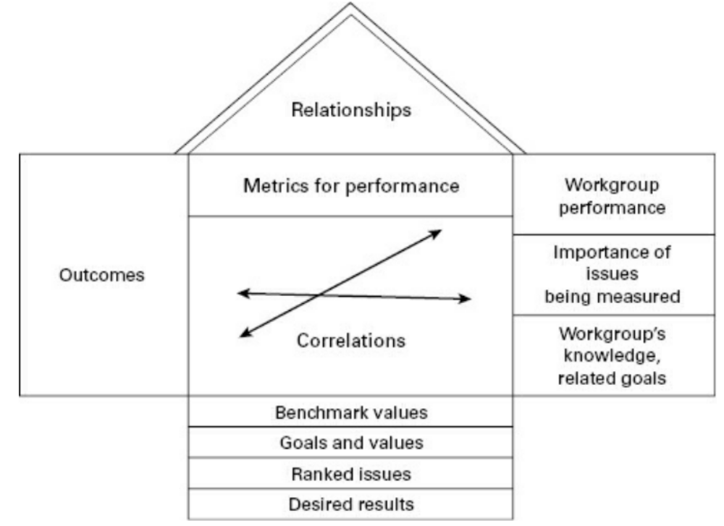
KM Return on Investment (ROI) and Metrics
The House of Quality Method

Slide 13
KM Return on Investment (ROI) and Metrics
Tiwana (2000) recommends using indicators and other useful parameters from the Skandia Intellectual Capital annual report instrument as house of quality outcomes in order to analyze KM effectiveness.

Slide 14
KM Return on Investment (ROI) and Metrics
These indicators include:
    1. Competence development expenses ($ per employee),
    2. Employee satisfaction,
    3. Time spent on systematic packaging of know-how for future reuse when a project has been completed
    4. Training expenses per employee,
    5. Information-gathering expenses per existing customer,
    6. Total number of patents held,

Slide 15
Measuring the Success of Knowledge Networks
There are three types of value that can result (Krebs, 2008):
  1. Structural value: The creation of connections in a network; the amount of time spent in interacting with others; the flow of knowledge among network members (typically measured using social network analysis [SNA] techniques)
  2. Relational value: The maintenance of connections; their longevity; the degree of reciprocity in network interactions (typically assessed through surveys and anecdotes)
  3. Cognitive value: The commonality or cohesiveness of the network (which can be assessed through SNA and interviewing techniques)

Slide 16
Measuring the Success of Knowledge Networks
Stories are a good way to illustrate the links between community activities, performance outcomes, and value. Some sample questions to elicit such stories would be:
  What would have not happened without this CoP in place?
  Did you save time because you had access to the community resources, including other people?
  Did you find the answer to a question more quickly or did you solve a problem more rapidly?
  Has your decision-making confidence increased since you have become a member of this CoP?

Slide 17
Measuring the Success of Knowledge Networks
Social network analysis (SNA) is a good tool to map out the patterns of network interactions. SNA can also be very useful in establishing a baseline measure for a given CoP and be used to track changes over time as well as to identify “hidden experts.”
Hidden experts are readily visible in a social network map as they appear as a node at the center of dense connections, people who can quickly connect you to other people or to valuable content because they just know who knows what and where the useful knowledge resides.

Slide 18
Measuring the Success of Knowledge Networks
Benefits of a CoP to an individual, to the community, and to the organization:
Individual (how does an individual participating in a CoP benefit?)
  Skills and know-how increased
  Increased personal productivity
  Increased job satisfaction
  Enhanced personal reputation
  Increased sense of belonging

Slide 19
Measuring the Success of Knowledge Networks
Benefits of a CoP to an individual, to the community, and to the organization:
Community (how does the collective benefit?)
  Increased availability and access to knowledge, expertise, and resources
  Easier to reach a consensus
  Faster problem solving
  Enhanced community reputation and legitimacy
  Increased trust between members

Slide 20
Measuring the Success of Knowledge Networks
Benefits of a CoP to an individual, to the community, and to the organization:
Organization (how does having this CoP benefit the host organization?)
  Improved operational efficiency
  Increased cost savings
  Increased avoidance of problems
  Improved quality of service
  Increased speed of service
  Increased employee retention/decreased turnover

Slide 21
Summary
Identify the major types of value that KM can create for organizations, groups, and individual employees.
Understand the major advantages and shortcomings of the KM metrics.
Apply the benchmarking, house of quality, and balanced scorecard methods and the results based assessment framework to knowledge management performance measurement systems.

Slide 22

Discussion / Homework / Team Activities
KM metrics remains an issue, as it is often only too easy to measure the costs of implementing KM whereas the benefits prove too elusive to measure. Discuss this KM issue: what are some of the methods and measures that can be used to make KM benefits less elusive?
Compare and contrast the three KM metrics of benchmarking, BSC, and house of quality. What are their major advantages and major drawbacks in monitoring progress toward strategic KM and business goals?
What does the results-based approach offer that other methods do not?
How would you go about assessing the value of a CoP?

Slide 23

Discussion

